Slide 1
Stochastic Model of Short-Term Prediction of Stock Prices and It’s Profitability in The Czech Stock Market
Achmad Faiz Siraj 1706043046 Geraldy Christanto 1706043001 Muhammad Koku 1706043203

Slide 2
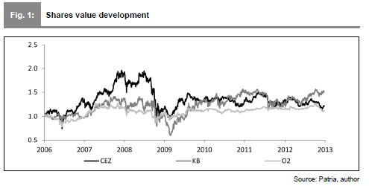
Data
Notes:
O2: Telefonica O2
KB: Komercni Banka
CEZ: CEZ Group (Perusahaan minerba)

Slide 3


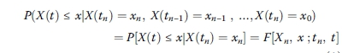
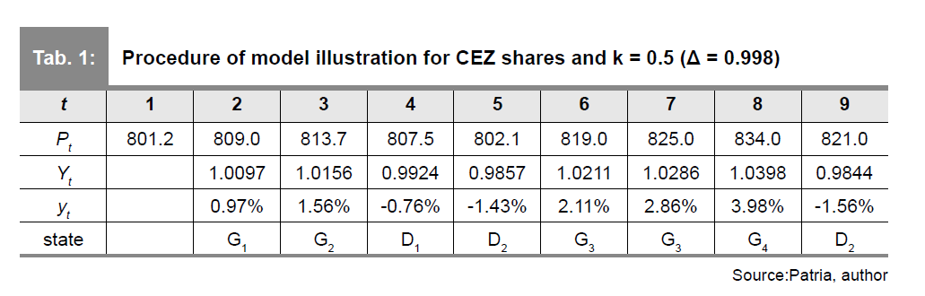

Method
State Space
Markov Chain
Notes:
Yt : Cumulative share price change
yt: Yt expressed as a percentage
Pt : daily closing price in time t
State space di definisikan berdasarkan yt. Ada 8 state,
D1 : state with the lowest price decrease
D1 < D2 < D3 < D4
D4 : Highest price decrease
G1: State with lowest price growth
G1 < G2 <G3 <G4

Slide 4
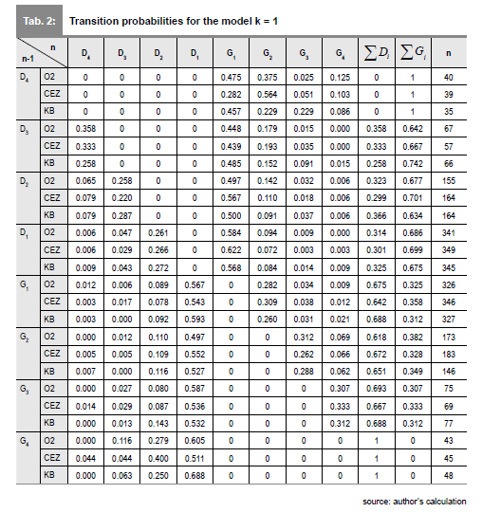
RESULT
Notes:
JELASIN KALO D BAKAL BELI, KALO G BAKAL JUAL!!!!!!!!!!!

Slide 5
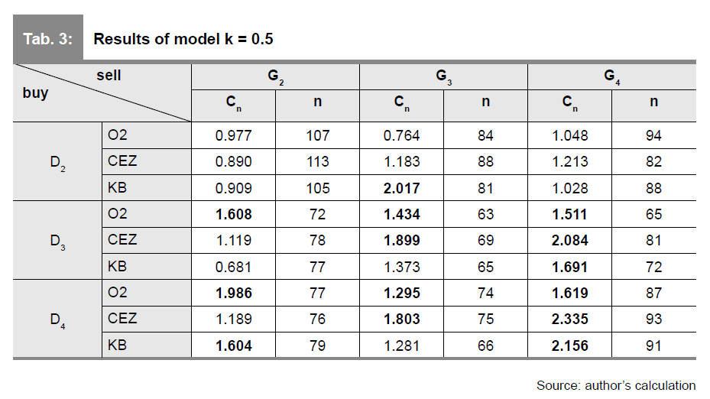
Comparison Buy & Hold Results and Stochastic Method
O2: 1.122 CEZ: 1.227 KEB:1.502

Slide 6
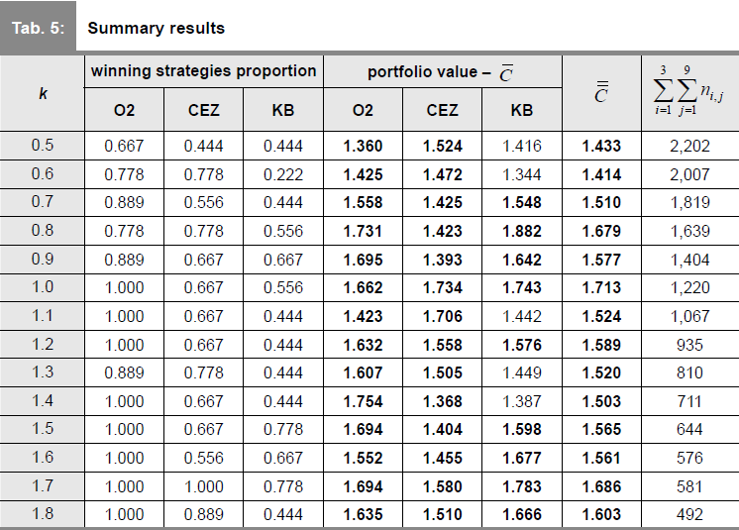

Slide 7
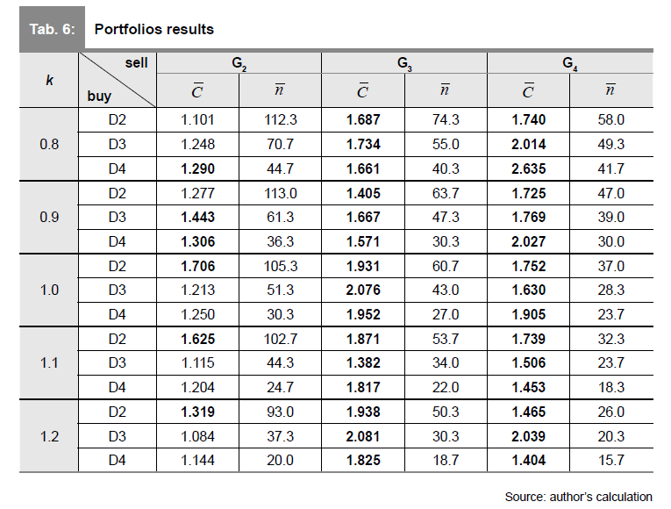

Slide 8
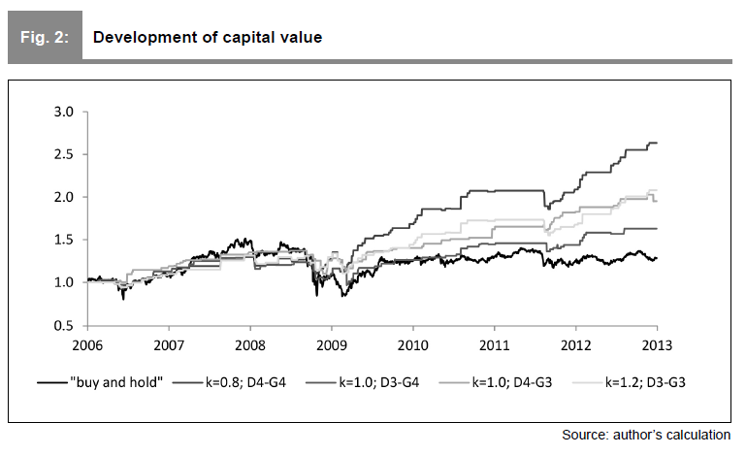

Slide 9
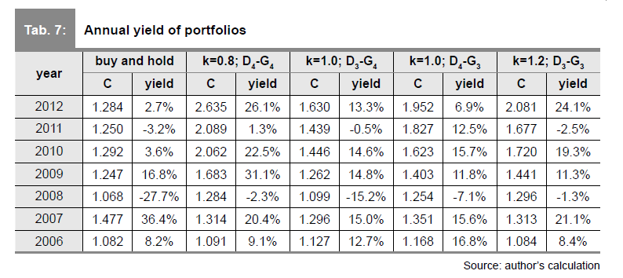

Slide 10
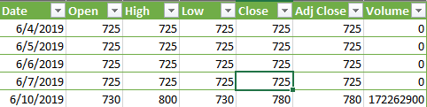
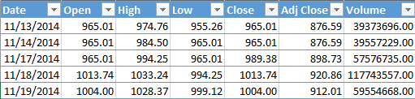
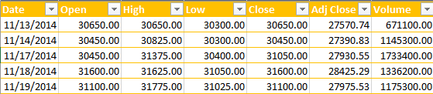
Next Research
Reimplementation of these models in other stock markets
WSKT, UNVR, ANTM*
Green: ANTM
Blue : WSKT
Yellow: UNVR
Source: finance.yahoo.com/

Slide 11
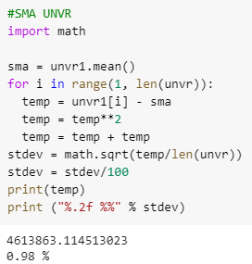
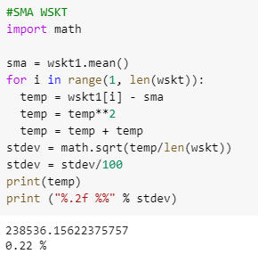
STATE SPACE
Standard Deviation For UNVR
Standard Deviation For WSKT

Slide 12
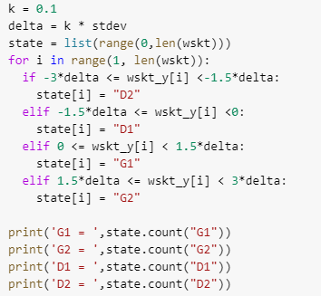

STATE SPACE
Number of data on each state
WSKT State Space For k = 0.1

Slide 13
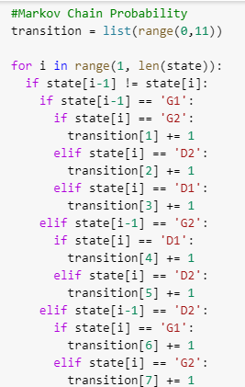
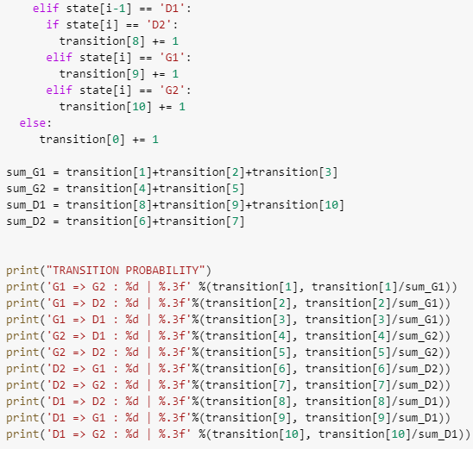
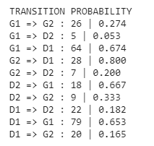
Markov Chain Probability
Based on WSKT State Space
Transition Probability For WSKT

